Slide 2
Building, Running, Patching Docker Containers – The Paradigm Shift
Steve Lasker
Program Manager – Azure Developer Experiences
@stevelasker
BRK2115
Notes:
Building Resilient Microservices with .NET Core and Azure Container Services (AKS)
Code: BRK2141
Type: Breakout 45 minute
Track(s): Applications and Infrastructure
Speaker(s): Glenn Condron, Steve Lasker
Timeslot: Monday, May 7 2:45 PM-3:30 PM
Abstract:Microservices are highly scalable, resilient, and composable units of deployment for modern applications. But building them is hard. There are a lot of development and deployment considerations to take into account. In this session we'll show you how we're making .NET Core microservices easier to build with new application patterns in .NET Core 2.1 as well as how to deploy and manage them with Kubernetes and Helm.

Slide 3
Containers are a way to wrap up an application into its own isolated box. This isolation empowers Developers and IT Operations to collaborate effectively as they have clear boundaries of configuration and execution. Come learn how adopting a container workflow and lifecycle management empowers change and stability from the first release. As a developer, you’ll see testing your build pipeline, before you commit your code and how the build pipeline is used for OS & Framework patching during and after active development. Come see how containers are a paradigm shift to a modern DevOps workflow, that will take some change, but empowers your company to new levels of collaboration. Also learn how to use Azure Container Registry (ACR) build to simplify container development and building by easily storing and managing container images for Azure deployments in a central registry

Slide 4
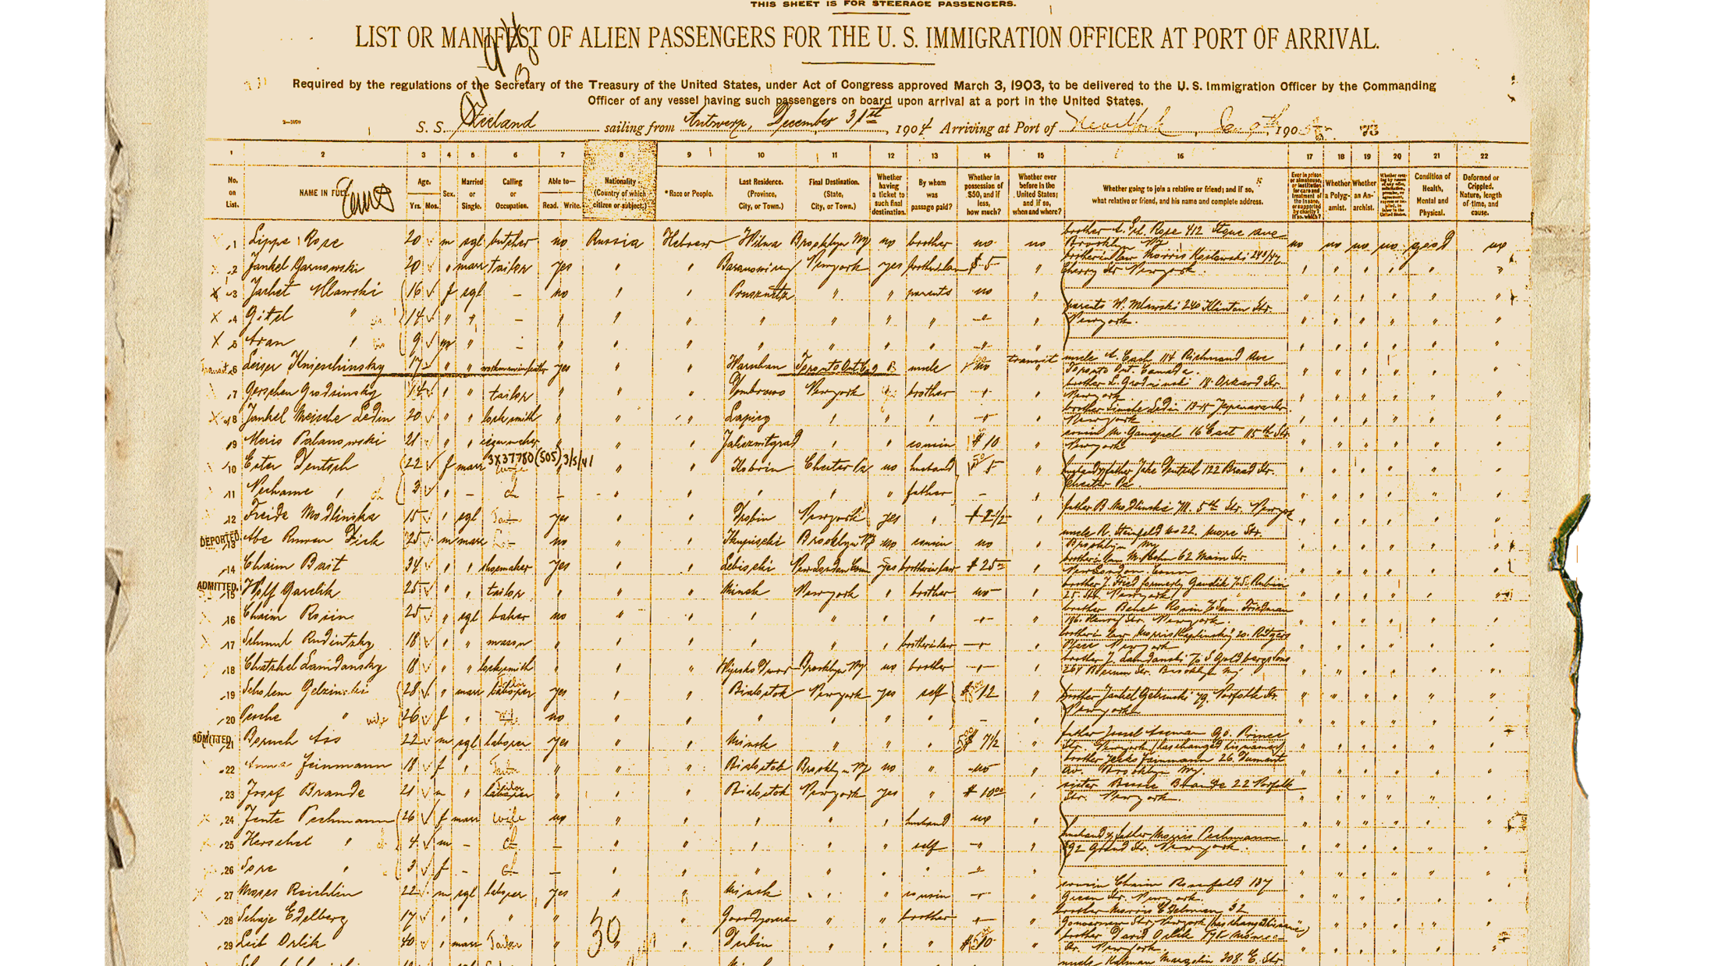
Shipping Manifest
Building
Building your code, with a container first mindset
Running
Prepare your code to run
Deploying updates to your code
Patching
Patching – the paradigm shift
Reaping the rewards of your efforts

Slide 5

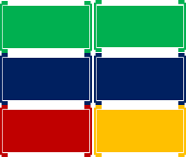
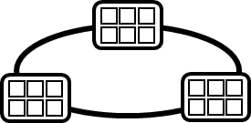



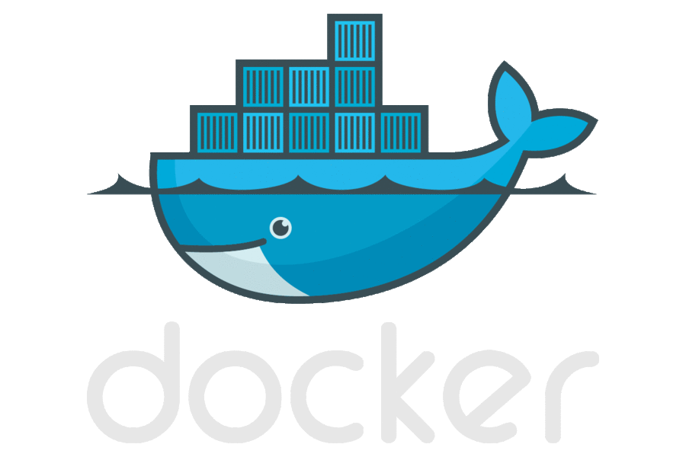



Today’s Container DevOps Workflow
Container Service
OS & Framework Patching
What happens when developers stop making code changes?
Run, Manage
Container Instances
Source Code Control
(SCC)
Build/CI,
Integrate,
Test
CD, Deploy
App Services
Production
environments
Service Fabric
Azure Functions
IoT
Inner-Loop
Azure Batch
Run
Monitor and Diagnose
Code
Validate
Debug

Slide 6
Demo
Docker Build
Docker Run
…the inner loop

Slide 7
Multi-Stage Builds
FROM microsoft/aspnetcore:2.0 AS base
WORKDIR /app
FROM microsoft/aspnetcore-build:2.0 AS build
WORKDIR /src
COPY HelloWorld.sln ./
COPY HelloWorld/HelloWorld.csproj HelloWorld/
RUN dotnet restore -nowarn:msb3202,nu1503
COPY . .
WORKDIR /src/HelloWorld
RUN dotnet build -c Release -o /app
FROM build AS publish
RUN dotnet publish -c Release -o /app
FROM base AS final
WORKDIR /app
COPY --from=publish /app .
ENTRYPOINT ["dotnet", "HelloWorld.dll"]
dotnet build
ENTRYPOINT ["dotnet", "HelloWorld.dll"]
copy source
COPY --from=publish /app
nuget restore
final
COPY .csproj
COPY .sln
microsoft/aspnetcore-build
microsoft/aspnetcore
dotnet publish
publish

Slide 8

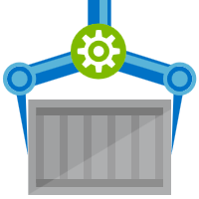

Extracting Configuration
web:1
A build image shall be deployable across multiple environments
Container Builder
Container Registry
web:1
web:1
web:1
web:1
web:1
1
web:1
docker build –t web:1
docker push web:1
Expense
Integration
Staging
Production
web:1
Production 2
Web:1
Web:1
Web:1
Web:1
Web:1
Integration
Staging
Prod-Marketing
Prod-Finance
Prod-Mfr
Staging Env
Production
Production 2
Production 3

Slide 9
Demo
Configuration Provider - extracting settings from your container

Slide 10
Committing Code
Are you ready to deploy?
Can your container be built?
What about configuring build systems…

Slide 11






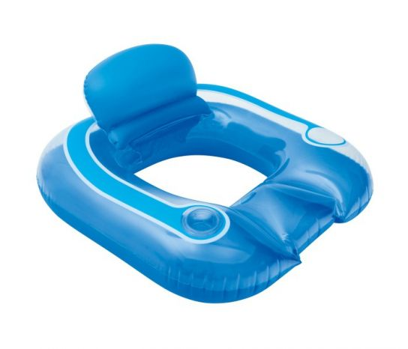

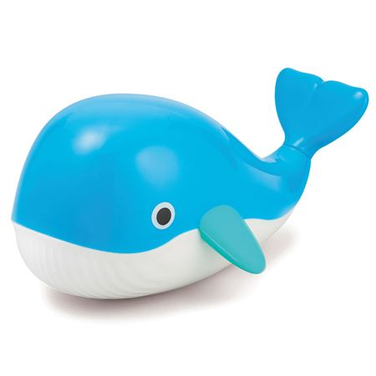



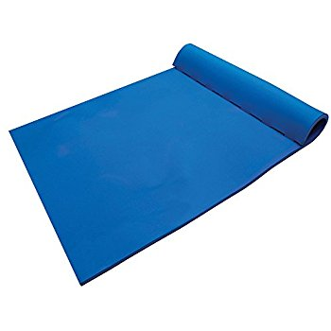
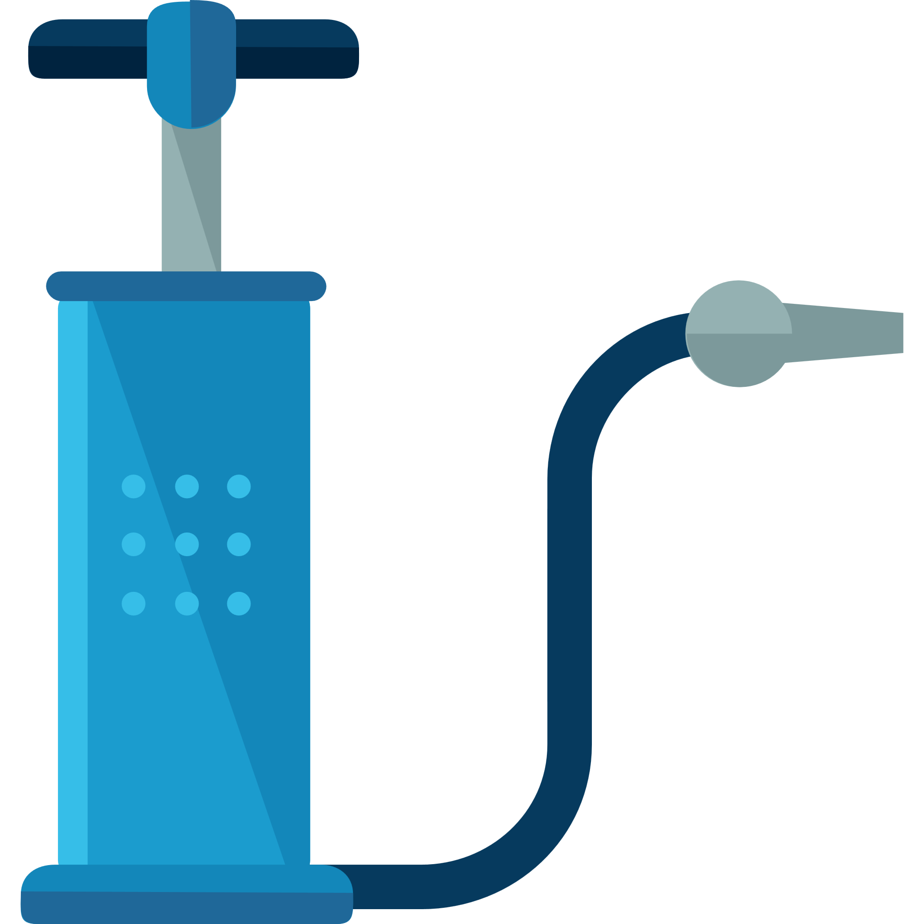


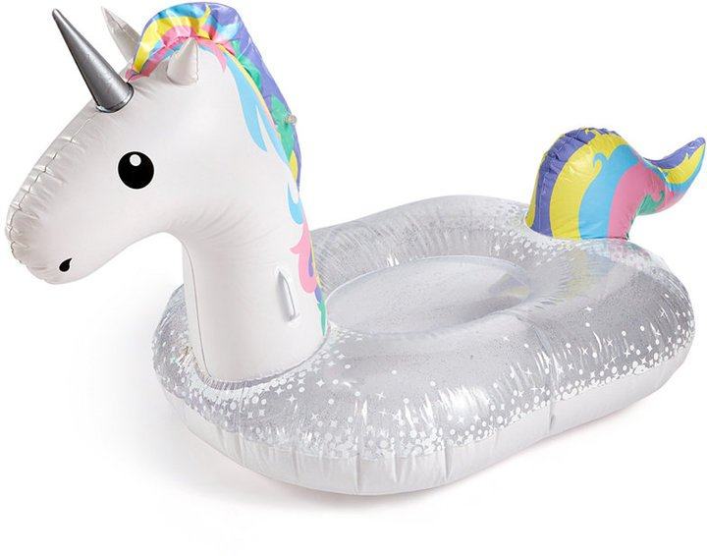

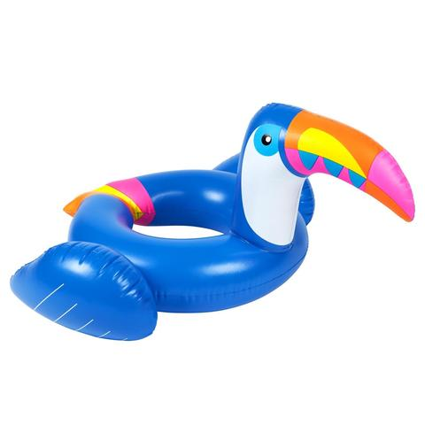

Current Build Infrastructure
Build, Integrate, Test
Hosted Build Agent Pool
Contoso – Build Pool
Northwind – Build Pool

Slide 12
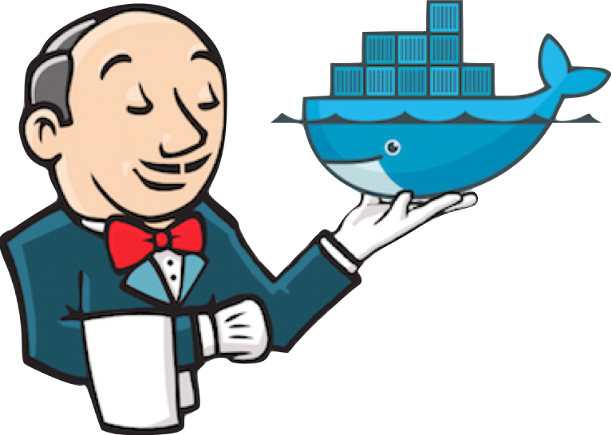
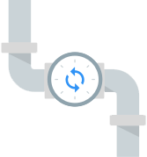


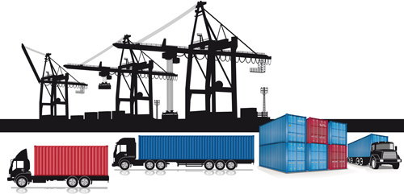
Native Container Builds
Build, Integrate, Test
Hosted Build Agent Pool

Slide 13

Announcing ACR Build

Slide 14
ACR Build
Native Container Build Service
Follows docker build semantics
docker build –t helloworld:v1 .
az acr build –t helloworld{{.Build.ID}} .
Inner-loop pre check-in validations
Trigger based builds (git commits, base image updates)
az acr build-task create –-image helloworld{{.Build.ID}}
--name myBuildTask
--registry jengademos
--context https://github.com/me/helloworld
--branch master
--git-access-token $PAT

Slide 15
Demo
Deploying to AKS w/Helm
Azure Kubernetes Service
Managing Reliable & Unreliable Services
Notes:
High-level, walk through a helm chart
Helm upgrade

Slide 16
Demo
ACR Build
Inner loop
trigger builds on git commits
but, wait, there’s more…

Slide 17
Testing Built Containers…

Slide 18
Testing Built Containers
FROM microsoft/aspnetcore:2.0 AS base
WORKDIR /app
EXPOSE 80
FROM microsoft/aspnetcore-build:2.0 AS builder
ARG BuildConfiguration=Release
WORKDIR /src
COPY *.sln ./
COPY Web/Web.csproj Web/
RUN dotnet restore
COPY . .
WORKDIR /src/Web
RUN dotnet build -c $BuildConfiguration -o /app
FROM builder AS publish
ARG BuildConfiguration=Release
RUN dotnet publish -c $BuildConfiguration -o /app
FROM base AS production
WORKDIR /app
COPY --from=publish /app .
ENTRYPOINT ["dotnet", "Web.dll"]
FROM microsoft/aspnetcore:2.0 AS base
WORKDIR /app
EXPOSE 80
FROM microsoft/aspnetcore-build:2.0 AS builder
ARG BuildConfiguration=Release
WORKDIR /src
COPY *.sln ./
COPY Web/Web.csproj Web/
RUN dotnet restore
COPY . .
WORKDIR /src/Web
RUN dotnet build -c $BuildConfiguration -o /app
FROM builder AS test
WORKDIR /src/Web.test
RUN dotnet test
FROM builder AS publish
ARG BuildConfiguration=Release
RUN dotnet publish -c $BuildConfiguration -o /app
FROM base AS production
WORKDIR /app
COPY --from=publish /app .
ENTRYPOINT ["dotnet", "Web.dll"]
Unit Tests
Multi-stage dockerfiles
Functional Tests
Test containers
test:1
web:1
test:1
web:1
Integration Env

Slide 19
Deployment

Slide 20

Service Boundary Definition
Helm Charts
Kubernetes application deployment declaration
A set of “files” that describe the intent of what you want deployed
Values to fill in for incremental deployments
Name & Version
Collection of expandable Go templates, used to generate a Kubernetes Deployment file ^{(Similar to T4)}
Solves dynamic values used for each deployment
Chart.yaml
Values.yaml
\templates
webapp.yaml
quotesapi.yaml
secrets.yaml
_helpers.tpl
\charts
nginx-ingress-0.12.0.tgz
Custom template, for not-yet-known standards
A complete chart for an existing thing
RabbitMQ, NGINX, Jenkins

Slide 21
Helm – what are the controls you need to know?
Initial Deployment
helm install [directory] –n [name]
Upgrading an existing deployment
helm upgrade [name] [directory]
helm upgrade demo42 .
--reuse-values \
--set [name]=value

Slide 22
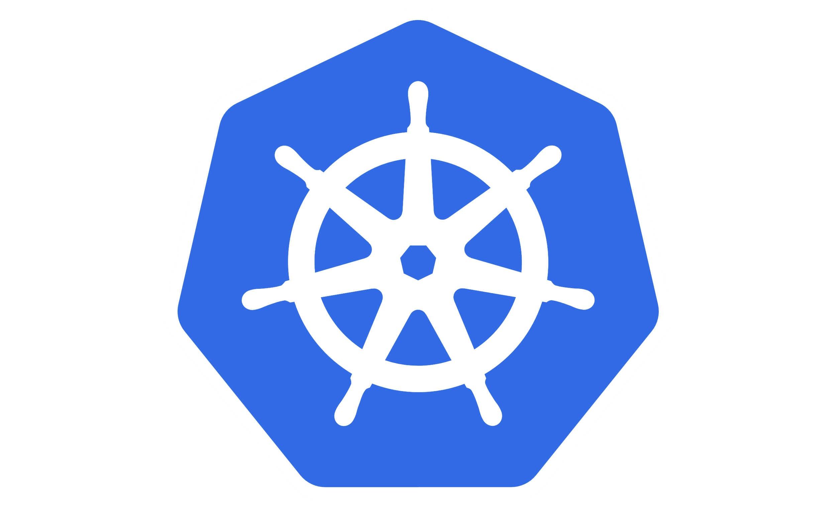
Deploying & Managing Reliable Systems

Slide 23

Deployment
Container Service
Container Instances
App Services
Service Fabric
SQL Data Services
coming soon
…

Slide 24



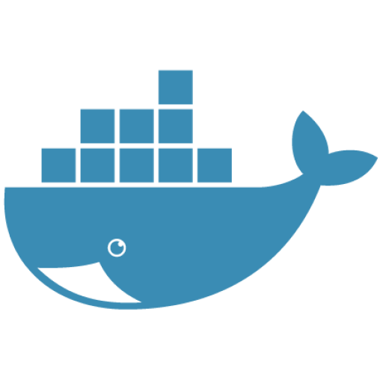


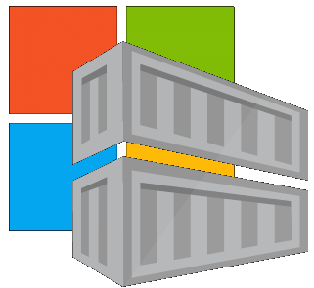


Image Lifecycle Primitives
5
… Service
Build/CI,
Integrate,
Test
Host agents monitor, protect and report running containers
(Azure Security Center*)
CD, Deploy
.NET
11
Upon release, set released flag in ACR (ACR-Auto-purge policies)
3
Base Image Index
9
7
1
2
Docker Hub
Helm Chart Repository
8
Azure Container _Builder*
Azure Container Registry
Azure Container Registry
Maintain Deployment Artifacts *
Microsoft Container Registry*
Image Security Scanning (Azure Security Center*)
Inner-Loop
Run
4
6
10
Code
Validate
Debug
Azure Event Grid
Image Usage Logs
(ACR/Azure Security Center*)

Slide 25

Release Management
Resource Pool
Orchestration
HOST-A
Deploy:
web:1 x3
api:1 x3
cache:1 x4
Image Cache
3
web:1
digest: 91e
web:1
digest: 91e
Foo:
web:1 x3
api:1 x3
cache:1 x4
web:1
digest: 91e
api:1
digest: u82
Container Builder
cache:1
digest: 2re
cache:1
digest: 2re
Container Registry
HOST-B
Image Cache
api:1
digest: u82
api:1
digest: u82
7
6
api:1
digest: u82
5
web:1
digest: 91e
api:1
digest: u82
cache:1
digest: 2re
api:1
digest: u82
cache:1
digest: 2re
1
cache:1
digest: 2re
docker build –t web:1
docker build –t api:1
docker build –t cache:1
docker push web:1
docker push api:1
docker push cache:1
cache:1
digest: 2re
cache:1
digest: 2re
Image
web:1
api:1
cache:1
2
Digests
91e
u82
2re
web:1
digest: 91e
HOST-C
api:1
digest: u82
4
cache:1
digest: 2re
8
Image Cache
api:1
digest: u82
api:1
digest: u82
cache:1
digest: 2re
cache:1
digest: 2re
Notes:
Orchestrator icon from: http://cdn.marketplaceimages.windowsphone.com/v8/images/f58edb21-b20c-4315-b837-6cee21n442cd?imageType=ws_icon_large
https://git-scm.com/book/en/v2/Git-Branching-Basic-Branching-and-Merging

Slide 26
Image Tagging
Why stable tagging can create instability

Slide 27
HOST-A
Deploy:
web:1 x3
api:1 x3
cache:1 x4
Image Cache
3
web:1
digest: 91e
web:1
digest: 91e
Foo:
web:1 x3
api:1 x3
cache:1 x4
web:1
digest: 91e
api:1
digest: u82
api & cache are inconsistent states
1
cache:1
digest: 2re
cache:1
digest: 2re
docker build –t web:1
docker build –t api:1
docker build –t cache:1
docker images
REPOSITORY TAG DIGEST
web 1 91e
api 1 u82
cache 1 2re
docker push web:1
docker push api:1
docker push cache:1
HOST-B
Image Cache
api:1
digest: u82
api:1
digest: u82
9
8
api:1
digest: 3rp
5
api:1
digest: u82
cache:1
digest: 2re
api:1
digest: u82
cache:1
digest: 2re
web:1
digest: 91e
cache:1
digest: 1n4
cache:1
digest: 2re
cache:1
digest: 2re
Digests
91e
u82
2re
Image
web:1
api:1
cache:1
2
Digests
91e
u82
2re
3rp
1n4
web:1
digest: 91e
HOST-C
api:1
digest: u82
7
4
cache:1
digest: 2re
Image Cache
api:1
digest: 3rp
api:1
digest: 3rp
6
docker build –t api:1
docker build –t cache:1
docker images
REPOSITORY TAG DIGEST
api 1 3rp
cache 1 1n4
docker push api:1
docker push cache:1
cache:1
digest: 1n4
cache:1
digest: 1n4
api:1
digest: 3rp
cache:1
digest: 1n4
Notes:
Orchestrator icon from: http://cdn.marketplaceimages.windowsphone.com/v8/images/f58edb21-b20c-4315-b837-6cee21n442cd?imageType=ws_icon_large
https://git-scm.com/book/en/v2/Git-Branching-Basic-Branching-and-Merging

Slide 28
Tagging Techniques
Stable Tags
Tag
:latest
:1
:2
:3
:1.0
:1.1
:1.2
:2.0
:2.1
:3.0
Digest
91efj6
u82lq
2re7f
3rpn1
1n4ef
5wd1k
Servicing Stable Tags
Tag
:latest
:1
:2
:1.0
:1.1
:1.2
:2.0
Digest
91efj6
u82lq
e8s1f
1n4ef
2re7f
3rpn1
28efq
Unique Tagging
Tag
:12204
:12328
:12401
:33810
:35091
:4201
:50201
Digest
91efj6
u82lq
e8s1f
1n4ef
2re7f
3rpn1
28efq
Notes:
[‎2/‎23/‎2018 3:18 PM] Sajay Antony:
https://git-scm.com/book/en/v2/Git-Branching-Basic-Branching-and-Merging
[‎2/‎23/‎2018 3:37 PM] Sajay Antony:
https://docs.docker.com/storage/storagedriver/
[‎2/‎23/‎2018 4:00 PM] Sajay Antony:
https://www.cockos.com/licecap/
[‎2/‎23/‎2018 5:10 PM] Sajay Antony:
https://docs.docker.com/datacenter/dtr/2.4/guides/user/create-promotion-policies/

Slide 29
Image Tagging
Base Images
Deployed Images
Always Unique
Stable Tags create instability
Build IDs are a great source
{buildsystem}-{build_id}
10192409
1833583
305305t035
Stable Tags
:latest
:1.0
:1.1.1.1
:2.0
:2.2.1

Slide 30
Microservice Resiliency
Coding for failure…

Slide 31


Base image indexing
ACR Build
ACR
Dockerfile FROM
Functional Tests
Base Images
Commit Id
Build-task
Id
Context
Dependencies
ACR
Quorum-Task
Web-Build
Context
Dependencies
Integration Env
Features provided by ACR:
Base image indexing
ACR
Dockerhub
MCR
ACR Build
Saving of the context/git commit & dependency list
Image Quarantine
Events for “image-quarantine” w/integrations with Aqua & Twistlock
Quorum Task
Async eventing for a collection of tags
Staging Env

Slide 32


Dockerfile FROM
Functional Tests
Base Images
Commit Id
Build-task
Id
Context
Dependencies
ACR
Quorum-Task
fx:1^{(a)}
fx:1
d5ab1fa
Web-Build
1
fx:1
web:sha@l
web:1
web:1
deploy/test
deploy
web:1
web:1
test:t
Context
d5ab1fa
test:1
Dependencies
web:1
Integration Env
FROM jenga.azurecr.io/baseimages/fx:1
COPY . /output
EXPOSE 80
ENTRYPOINT ["entryPoint"]
Quarantined Images will take some time to be scanned, and are asynchronous
web:1
If docker build succeeds (including any unit tests),
Save the context & base image dependencies
az acr build-task create –n Web-Build –t web:${{build.Id}} –c github.com/stevelasker/web –r jenga
A quorum task awaits a specific tag to arrive, which can then call a webhook/Azure Event Grid
Staging Env
Quorum task receives the specific tag(s) it’s waiting for and calls the next webhook

Slide 33
Dockerfile FROM
Functional Tests
Base Images
Commit Id
Build-task
Id
Context
Dependencies
ACR
Quorum-Task
fx:1^{(a)}
fx:1
d5ab1fa
Web-Build
1
fx:1
web:sha@l
web:1
web:1
deploy/test
deploy
Context
fx:1^{(b)}
fx:1^{(b)}
2
fx:1^{(b)}
web:sha@n
web:2
web:2
deploy/test
deploy
web:2
web:2
d5ab1fa
test:2
test:2
Dependencies
fx:1^{(a)}
web:2
fx ships an OS &/or FX Patch, using the stable 1 tag
The build-task is monitoring changes based on the last build
Integration Env
Base image updates restore the previous context
If Build & Unit Tests Succeed,
Update the base image dependencies
web:2
Staging Env

Slide 34
Dockerfile FROM
Functional Tests
Base Images
Commit Id
Build-task
Id
Context
Dependencies
ACR
Quorum-Task
fx:1^{(a)}
fx:1
d5ab1fa
Web-Build
1
fx:1
web:sha@l
web:1
web:1
deploy/test
deploy
Context
fx:1^{(b)}
fx:1^{(b)}
2
fx:1^{(b)}
web:sha@n
web:2
web:2
deploy/test
deploy
web:2
d5ab1fa
web:2
Dependencies
fx:1^{(b)}
Promote a Patch-task to maintain the production environment
Monitors base image updates, not git commits
Integration Env
Promote build #2 to Prod (Env)
web:2
az acr patch-task create –n Web-Patch –t web:2 –r jenga --webhook "myRelease.url"
Staging Env
Patch-task
Id
Context
Dependencies
Web-Patch
deploy
Context
d5ab1fa
Staging Env
Dependencies
fx:1^{(b)}
fx:1^{(a)}
web:2
Prod Env

Slide 35
Dockerfile FROM
Functional Tests
Base Images
Commit Id
Build-task
Id
Context
Dependencies
ACR
Quorum-Task
fx:1^{(a)}
fx:1
d5ab1fa
Web-Build
1
fx:1
web:sha@l
web:1
web:1
deploy/test
deploy
Context
fx:1^{(b)}
fx:1^{(b)}
2
fx:1^{(b)}
web:sha@n
web:2
web:2
deploy/test
deploy
web:2
web:2
d5ab1fa
test:2
Dependencies
fx:1^{(b)}
Integration Env
fx ships an OS &/or FX Patch, using the stable 1 tag
web:2
Staging Env
Patch-task
Id
Context
Dependencies
test:3
3
fx:1^{(c)}
web:3
fx:1^{(c)}
Web-Patch
fx:1^{(c)}
web:sha@p
web:3
web:3
deploy/test
deploy
test:3
web:3
web:3
Context
d5ab1fa
Staging Env
Dependencies
fx:1^{(b)}
fx:1^{(a)}
web:2
web:3
Prod Env

Slide 36
Dockerfile FROM
Functional Tests
Base Images
Commit Id
Build-task
Id
Context
Dependencies
ACR
Quorum-Task
fx:1^{(a)}
d5ab1fa
Web-Build
fx:1
fx:1
Web-Build
1
web:sha@l
web:1
web:1
deploy/test
deploy
Context
fx:1^{(b)}
fx:1^{(b)}
2
fx:1^{(b)}
web:sha@n
web:2
web:2
deploy/test
deploy
web:2
web:2
ef26q5c
test:2
d5ab1fa
test:4
fx:2^{(d)}
fx:2^{(d)}
fx:2
ef26q5c
3
fx:2^{(d)}
web:sha@q
web:4
web:4
deploy/test
deploy
web:4
web:4
Dependencies
test:4
Dependencies
fx:1^{(a)}
fx:1^{(b)}
web:4
FROM jenga.azurecr.io/baseimages/fx:2
COPY . /output
EXPOSE 80
ENTRYPOINT ["entryPoint"]
Integration Env
Quarantined Images will take some time to be scanned, and are asynchronous
web:2
web:4
If docker build succeeds (including any unit tests),
Save the context & base image dependencies
A quorum task awaits a specific tag to arrive, which can then call a webhook/Azure Event Grid
Staging Env
Quorum task receives the specific tag(s) it’s waiting for and calls the next webhook
Patch-task
Id
Context
Dependencies
fx:1^{(c)}
3
fx:1^{(c)}
Web-Patch
fx:1^{(c)}
web:sha@p
web:3
web:3
deploy/test
deploy
test:4
web:3
web:4
Context
d5ab1fa
Staging Env
Dependencies
fx:1^{(b)}
fx:1^{(a)}
web:2
web:3
Prod Env

Slide 37
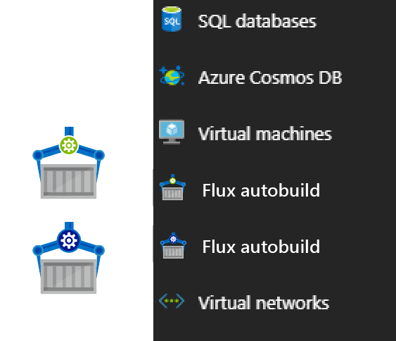
Contoso (Returns)
1 Pull Request
= 1 Build
= 1 Push
= 1 Scan
= 1 Test
= 1 Deploy
$$(1pr=1b+1p+ 1t+1d) ∗life of development$$
Contoso (*)
= 1 Build
= 1 Push
= 1 Scan
= 1 Test
= 1 Deploy
= 1 Build
= 1 Push
= 1 Scan
= 1 Test
= 1 Deploy
= 1 Build
= 1 Push
= 1 Scan
= 1 Test
= 1 Deploy
.NET
Northwind
= 1 Build
= 1 Push
= 1 Scan
= 1 Test
= 1 Deploy
= 1 Build
= 1 Push
= 1 Scan
= 1 Test
= 1 Deploy
= 1 Build
= 1 Push
= 1 Scan
= 1 Test
= 1 Deploy
Coke
= 1 Build
= 1 Push
= 1 Scan
= 1 Test
= 1 Deploy
= 1 Build
= 1 Push
= 1 Scan
= 1 Test
= 1 Deploy
= 1 Build
= 1 Push
= 1 Scan
= 1 Test
= 1 Deploy
Pepsi
= 1 Build
= 1 Push
= 1 Scan
= 1 Test
= 1 Deploy
= 1 Build
= 1 Push
= 1 Scan
= 1 Test
= 1 Deploy
= 1 Build
= 1 Push
= 1 Scan
= 1 Test
= 1 Deploy
Walmart
= 1 Build
= 1 Push
= 1 Scan
= 1 Test
= 1 Deploy
= 1 Build
= 1 Push
= 1 Scan
= 1 Test
= 1 Deploy
= 1 Build
= 1 Push
= 1 Scan
= 1 Test
= 1 Deploy
$$1patch=cust ∗apps ∗ \left(1b+1p+ 1t+1d\right)∗life of the app$$

Slide 38
Demo
.NET Core 2.1
Coding for Failure

Slide 39
Deploying & Managing Reliable Systems

Slide 40
Service Boundary Definition
Helm Charts
Kubernetes application deployment declaration

Slide 41
Demo
Deployment to AKS
Azure Kubernetes Service

Slide 42
Coming into port…
Building 100% reliability is like chasing chickens
Accept failure and you’ll sleep well at night
Use the modern tools and technologies
Containers are the “unreliable” packaging format
Orchestrators (Kubernetes) are your nighttime managers
Take the time to fully adapt – this is a paradigm shift
.NET Core 2.1 provides coding for the unreliable pattern

Slide 43
Scrub checklist
Upload your final deck on the speaker portal on or before May 4, 2018 at 5:00pm PST and receive priority for expedited deck scrub. If you are not able to upload the deck, bring it to the Speaker Workroom as soon as possible and your deck will be queued up to complete deck scrub.
The Scrub Process will include:
Verification that required slides are included
Remove any non-template logos and graphics from the walk-in slide
Remove any unused placeholder slides from the deck
Remove all comments, hidden slides and speaker notes from slides
Set file properties box
Reset printability to grayscale
Notify Speaker of any images identified as unlicensed for immediate resolution
Rename PPT file to match naming convention
Correct session title and session code to match Schedule Builder
PRINTING: This template is intentionally set to print in color or grayscale, not black and white
As speakers, you must:
Use the provided event template and associated colors, fonts, layout and transition slides
Correct product names to follow applicable branding rules
Remove any unlicensed images
Notes:
© 2010 Microsoft Corporation. All rights reserved. Microsoft, Windows, Windows Vista and other product names are or may be registered trademarks and/or trademarks in the U.S. and/or other countries.
The information herein is for informational purposes only and represents the current view of Microsoft Corporation as of the date of this presentation. Because Microsoft must respond to changing market conditions, it should not be interpreted to be a commitment on the part of Microsoft, and Microsoft cannot guarantee the accuracy of any information provided after the date of this presentation. MICROSOFT MAKES NO WARRANTIES, EXPRESS, IMPLIED OR STATUTORY, AS TO THE INFORMATION IN THIS PRESENTATION.

Slide 44

Brand photography library
Looking for photography resources?
Explore the library on Brand Central.

Slide 45

Illustration library
Looking for illustration resources?
Explore the library on Brand Central.

Slide 46
Section title

Slide 47

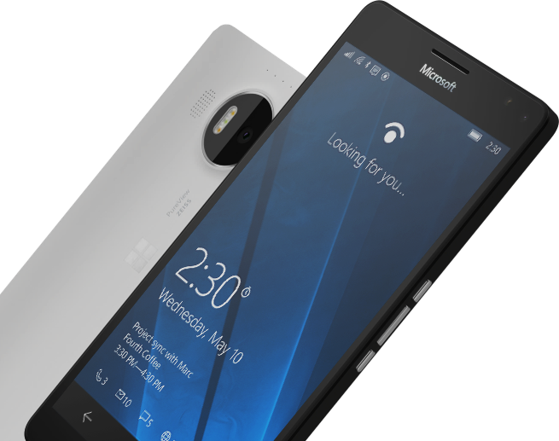
Please Complete An Evaluation Form for every session you attend. Your input is important!
#MSBuild

Slide 49
ACR Build
A feature of Azure Container Registry
aka.ms/acr/build
@SteveLasker
blogs.msdn.microsoft.com/SteveLasker

